Slide 1
OOPs
Object oriented programming

Slide 2
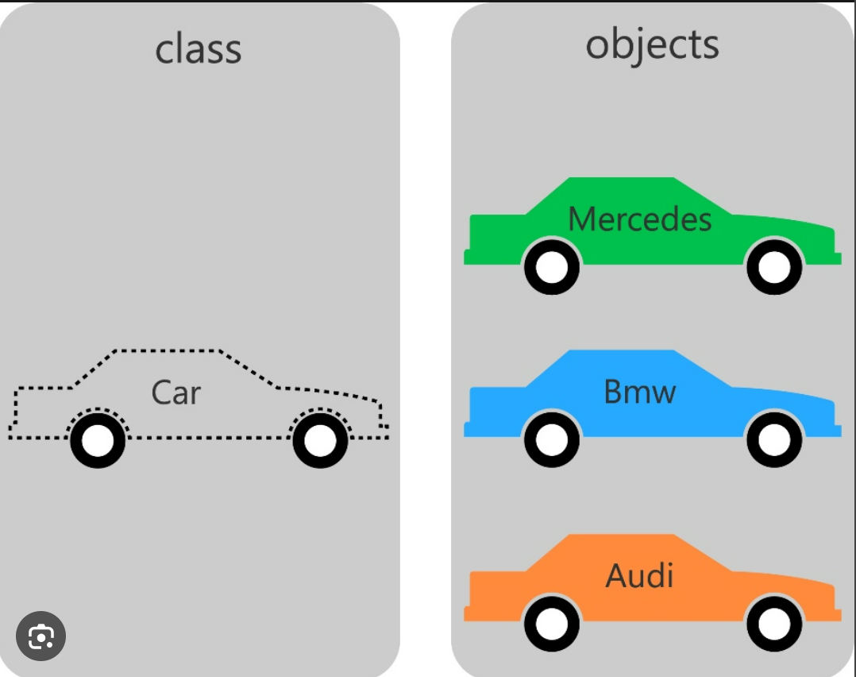
Classes and objects:

Slide 3
OOPs Concepts:
Abstraction
Inheritance
Encapsulation
Polymorphism

